Slide 1
Detecting Word Substitutions In Text
Presented by:
Vidhi Bhansali(6118)
Sayli Kapse(6137)
Tanvi Shah(6264)

Slide 2
Introduction
Criminals substitute certain words.
Detect replacements that have similar frequencies to the original words.
None of these measures are strong individually, but together they become effective.

Slide 3
Measures to detect substitutions:
K-Gram frequencies
Sentence Oddity
Pointwise Mutual Information(PMI)

Slide 4
K-Gram Frequencies
The frequencies of pairs of a given word with its neighbours on either side is calculated.
K-gram will be smaller for sentences containing the substitution.

Slide 5
Sentence Oddity
We compute the ratio of frequency of sentence to calculate sentence oddity.
SO=freq of bag of words with target word removed
freq of entire bag of words
SO will be larger for sentences containing the substitution.

Slide 6
Pointwise Mutual Information(PMI)
PMI attempts to measure the strength of an association between a word and some other string, either a word, a phrase, a sentence, or an entire document.
PMI=f(word)f(adjacent region)
f(word +adjacent region)
PMI will be larger for sentences containing the substitution.

Slide 7
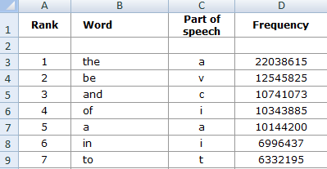
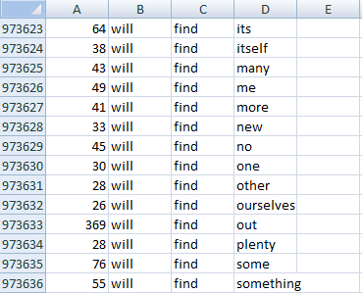
Database

Slide 8
Examples:
SENTENCE ODDITY:-
Original Sentence: KILL THE PRESIDENT.
Substituted Sentence: LOCAL THE PRESIDENT.
Frequencies :
KILL THE PRESIDENT : 34
LOCAL THE PRESIDENT:0
THE PRESIDENT: 79496
Formula :
Sentence Oddity = f(the president)/f(kill the president)
ODDITY FOR ORIGINAL SENTENCE: KILL THE PRESIDENT
Oddity = 79496/34
= 2338.117
ODDITY FOR SUBSTITUTED SENTENCE: LOCAL THE PRESIDENT
Oddity= 79496/0 i.e. infinite
The sentence oddity for a substituted sentence is very large. In our case it is infinity and hence is a substitution.

Slide 9
Examples:
PMI (Point wise Mutual Information)
Original Sentence: KILL THE PRESIDENT.
Substituted Sentence: LOCAL THE PRESIDENT.
Frequencies :
KILL : 92660
LOCAL : 92970
KILL THE PRESIDENT : 34
LOCAL THE PRESIDENT:0
THE PRESIDENT: 79496
Formula :
PMI FOR ORIGINAL SENTENCE: KILL THE PRESIDENT
PMI = (92660)(79496)/(34)
= 216649981.1764706
PMI FOR SUBSTITUTED SENTENCE: LOCAL THE PRESIDENT
PMI=(92970)( 79496)/0 i.e. infinite
The PMI for a substituted sentence is very large. In our case it is infinity and hence is a substitution.

Slide 10
Examples:
Original Sentence: KILL THE PRESIDENT.
Substituted Sentence: SUGGEST THE PRESIDENT
Frequencies :
kill : 92660
kill the president : 34
suggest : 92643
suggest the president : 0
Formula :
Avg. k-gram =[(Left k-gram + right k-gram)/2]
Left k-gram of KILL is "kill" (f=92660)
Right k-gram of KILL is "kill the president" (f=34)
Average k-gram: (92660+34)/2 = 46347
Left k-gram of SUGGEST is "suggest" (f=92643)
Right k-gram of SUGGEST is "suggest the president" (f=0)
Average k-gram: (92643+0)/2 = 46321.5
The K-Gram is smaller for the substituted sentence. Hence, there is a substitution.

Slide 11
Examples:
SENTENCE ODDITY:-
Original Sentence: KILL THE PRESIDENT.
Substituted Sentence: SUGGEST THE PRESIDENT.
Frequencies :
KILL THE PRESIDENT : 34
SUGGEST THE PRESIDENT:0
THE PRESIDENT: 79496
Formula :
Oddity = f(the president)/f(kill the president)
ODDITY FOR ORIGINAL SENTENCE: KILL THE PRESIDENT
Oddity = 79496/34
= 2338.117
ODDITY FOR SUBSTITUTED SENTENCE: SUGGEST HE PRESIDENT
Oddity= 79496/0 i.e. infinite
The sentence oddity for a substituted sentence is very large. In our case it is infinity and hence is a substitution.

Slide 12
Examples:
PMI (Point wise Mutual Information)
Original Sentence: KILL THE PRESIDENT.
Substituted Sentence: SUGGEST THE PRESIDENT.
Frequencies :
KILL : 92660
SUGGEST : 92643
KILL THE PRESIDENT : 34
SUGGEST THE PRESIDENT:0
THE PRESIDENT: 79496
Formula :
PMI FOR ORIGINAL SENTENCE: KILL THE PRESIDENT
PMI = (92660)(79496)/(34)
= 216649981.17
PMI FOR SUBSTITUTED SENTENCE: SUGGEST HE PRESIDENT
PMI=(92643)( 79496)/0 i.e. infinite
The PMI for a substituted sentence is very large. In our case it is infinity and hence is a substitution.

Slide 13
Additional functionalities
Spell Check:
To implement spell-check algorithm to find out if there are any wrong spellings in the file or document. This functionality is implemented using the PNC approach.
Synonym Detection:
To identify the possible substitutions of target words based on the synonyms.

Slide 14
Thank You.!

